Slide 1
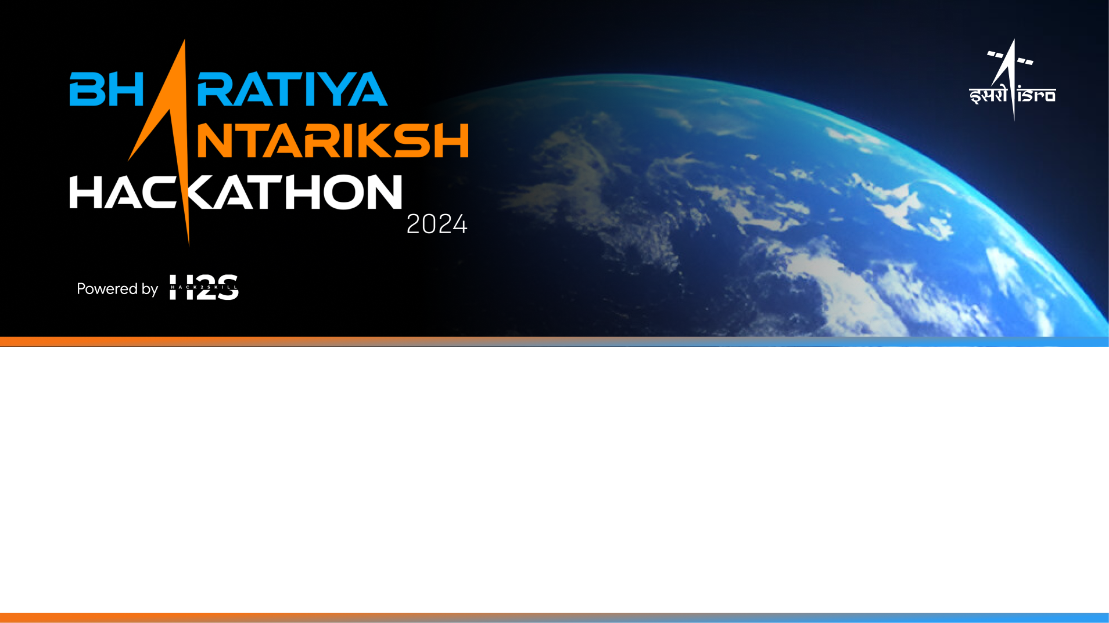
Team Name:SKYNITHERA
VELLORE INSTITUTE OF TECHNOLOGY :
Team Members Details:
1. NAVANITH HARSHITH GOWD(TEAM LEADER)
2. JANANI.A
3. RUTHIKA.J

Slide 2
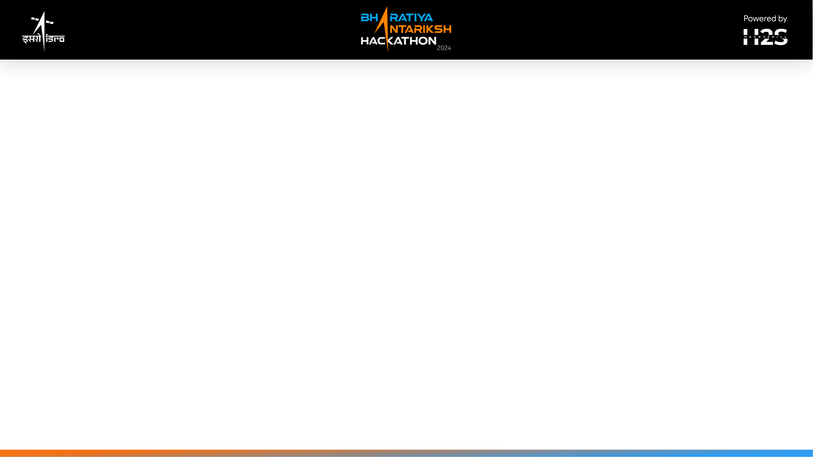
PROBLEM STATEMENT 3:
Automatic detection of craters & boulders from Orbiter High Resolution Camera(OHRC) images using AI/ML techniques
The automatic detection of craters and boulders from Orbiter High Resolution Camera (OHRC) images using AI/ML techniques involves utilizing advanced object detection models like YOLOv8 and Nanodet. These models are trained on annotated datasets to recognize the distinct features of craters and boulders. Post-processing steps refine detection accuracy by leveraging spatial context and shape analysis to differentiate craters and boulders from other surface anomalies. The approach ensures high precision ,recall by optimizing the models based on performance metrics for enhanced accuracy and reliability.

Slide 3
APPROACH
These models are trained on 2500 manually annotated high-resolution satellite images, achieving 92.91% accuracy in object detection with OHRC images. The use of annotated data significantly improves precision and recall compared to unannotated data, which achieves 90.96% accuracy. The approach includes data augmentation, spatial context, and shape analysis to refine detection results, highlighting the potential for further performance enhancement with a larger annotated dataset.

Slide 4
Tools and technologies used :
YOLOv8 and Nanodet for object detection
convolutional neural networks (CNNs) for feature recognition,
powerflow manual annotation tools for creating labeled datasets,training ,tetsing
Data augmentation techniques to enhance dataset diversity, and spatial context and shape analysis for post-processing to refine detection accuracy.

Slide 5
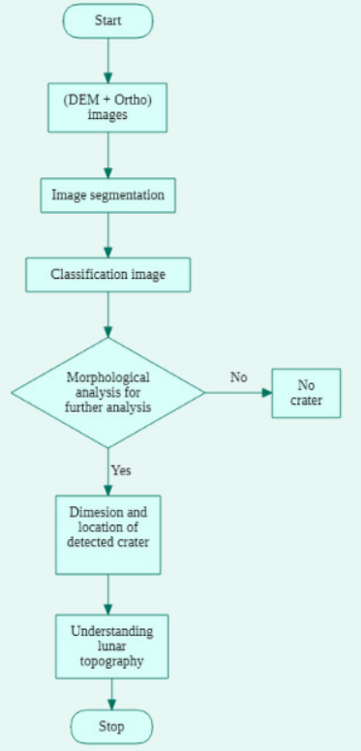
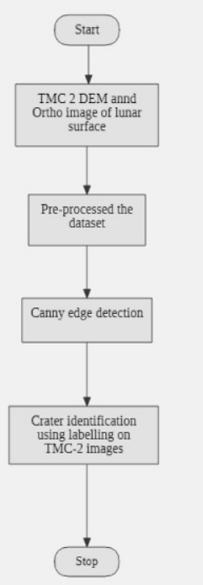

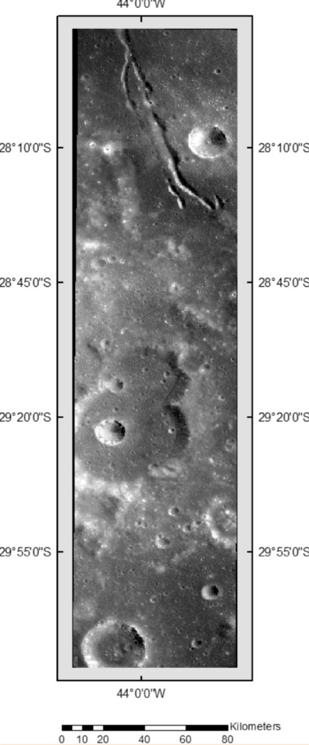
Proposed architecture/user diagram

Slide 6
Solution Brief (Overall):
our proposed solution utilizes state-of-the-art AI/ML techniques for the automatic detection of craters and boulders in Orbiter High Resolution Camera (OHRC) images. We employ YOLOv8 (You Only Look Once), renowned for its real-time object detection capabilities, combined with NanoDet, a lightweight and efficient object detection framework optimized for speed and accuracy. The process begins with preprocessing the OHRC images to enhance features relevant to crater and boulder identification. Subsequently, we train YOLOv8 and NanoDet models using a labeled dataset of craters and boulders. YOLOv8 provides robust detection in varying scales and illumination conditions, while NanoDet ensures rapid inference, making it suitable for real-time applications. The integration of these models leverages the strengths of both, offering high precision and low latency. Post-detection, the results are refined using non-maximum suppression to eliminate redundant detections. Our solution aims to achieve high accuracy, enabling efficient and automated analysis of lunar surface imagery, crucial for future lunar exploration missions.

Slide 7
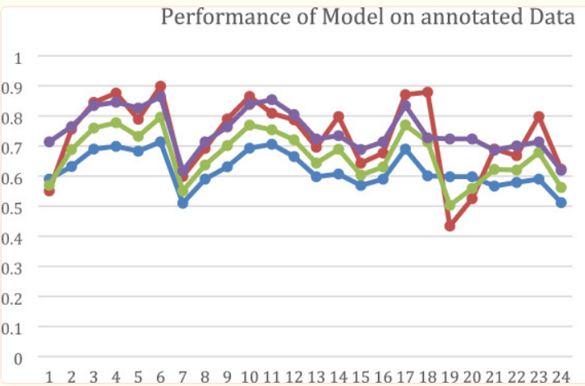
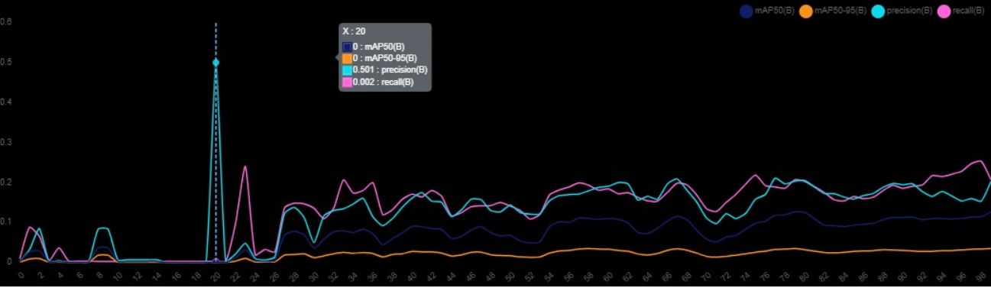
Performance on annotated data
The model demonstrated even better performance when evaluated on a dataset of two thousand annotated images. The F1 Measure ascended to 0.79589% and the accuracy to 86.91%

Slide 8
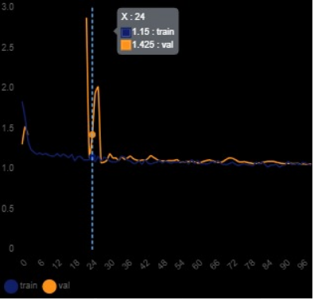
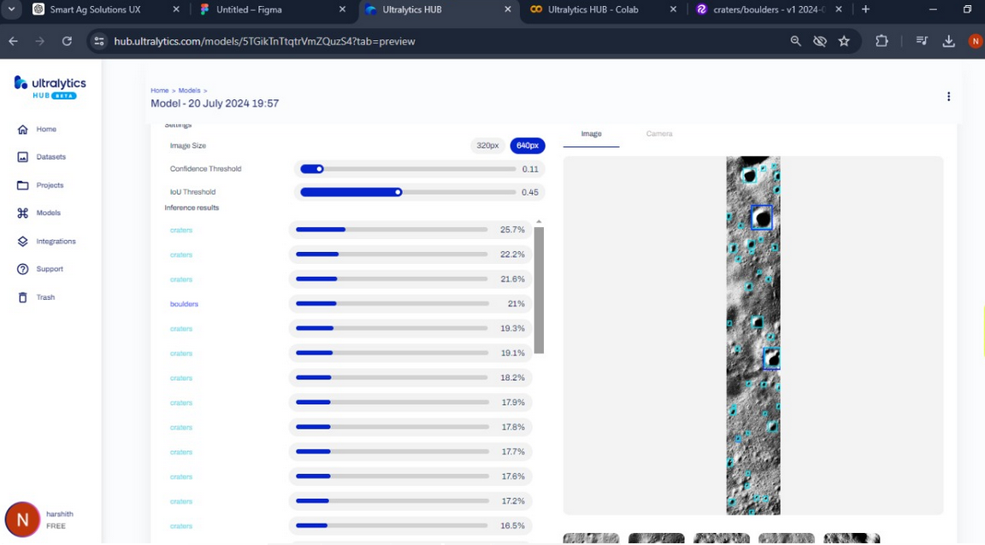
Novelty Approach:
Hybrid Model Deployment:
Utilized YOLOv8 for initial large-scale processing to quickly identify potential regions of interest (ROIs) with high precision.Deployed NanoDet for detailed analysis within the identified ROIs, for ensuring efficient use of computational resources high detection accuracy.
Ensemble Technique:
Combined the outputs of YOLOv8 and NanoDet to improve detection reliability. Used ensemble techniques such as non-maximum suppression (NMS) to merge predictions and reduce false positives.

Slide 9
